Slide 1
10.1: Sequences and Series
MATH 1550 - Precalculus

Slide 2


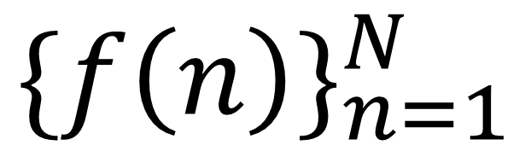
Sequence
Formula to use
Where the sequence ends
A sequence is a function $f\left(n\right)=a_{n}$ whose domain is $ℕ$.
The values (terms) of the sequence written in a particular order: $a_{1},a_{2},a_{3},…,a_{n},…$.
Written $\{f(n)\}_{n=1}^{N}$.
$$\{f\left(n\right)\}_{n=1}^{N}$$
Where the sequence begins
Ex) Write the 1st five terms of the sequence $\{2n−1\}_{n=1}^{∞}$.
Ex) Write the 1st five terms of the sequence ${\left\{{\frac{(−1)}{n}}^{n}\right\}}_{n=1}^{∞}$.

Slide 3

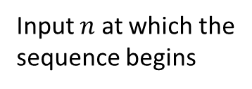

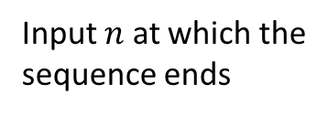
Sequence
Formula to use
Input $n$ at which the
sequence ends
A sequence is a function $f\left(n\right)=a_{n}$ whose domain is $ℕ$.
The values (terms) of the sequence written in a particular order: $a_{1},a_{2},a_{3},…,a_{n},…$.
Written $\{f(n)\}_{n=1}^{N}$.
$$\{f\left(n\right)\}_{n=1}^{N}$$
Input $n$ at which the
sequence begins
Ex) Write the 1st five terms of the sequence ${\left\{\frac{x^{n+1}}{n+1}\right\}}_{n=0}^{∞}$.
Ex) Find a formula $f\left(n\right)$ describing the terms of the sequence
given by: $\frac{1}{2},\frac{1}{4},\frac{1}{8},\frac{1}{16},\frac{1}{32},…$

Slide 4

Sequence
Formula to use
Input $n$ at which the
sequence ends
A sequence is a function $f\left(n\right)=a_{n}$ whose domain is $ℕ$.
The values (terms) of the sequence written in a particular order: $a_{1},a_{2},a_{3},…,a_{n},…$.
Written $\{f(n)\}_{n=1}^{N}$.
$$\{f\left(n\right)\}_{n=1}^{N}$$
Input $n$ at which the
sequence begins
Ex) Find a formula $f\left(n\right)$ describing the terms of the sequence given by: $1,−4, 9, −16, 25,…$

Slide 5


Factorials
If $n∈ℕ$, then $n!=n\left(n−1\right)\left(n−2\right)⋯3⋅2⋅1$, where $0!=1.$
Ex) Write the 1st five terms of the sequence ${\left\{\frac{x^{n}}{n!}\right\}}_{n=0}^{∞}$.

Slide 6


Factorials
If $n∈ℕ$, then $n!=n\left(n−1\right)\left(n−2\right)⋯3⋅2⋅1$, where $0!=1.$
Ex) Simplify $\frac{3!⋅4!}{2!⋅6!}$
Ex) Simplify $\frac{\left(n+2\right)!}{n!}$.

Slide 7



Recursive formulas
A sequence ${\left\{f\left(n\right)\right\}}_{n=1}^{N}$ is recursive if the current step relies on a previous step.
Usually $a_{0}$ or $a_{1}$ are provided as initial steps.
Ex) Write the 1st four terms of the sequence given by the formula $a_{n}=2a_{n−1}$, where $a_{1}=1$.
Ex) Write the 1st four terms of the sequence given by $x_{n+1}=\frac{x_{n}^{2}+2}{2x_{n}}$, given $x_{0}=1$.

Slide 8

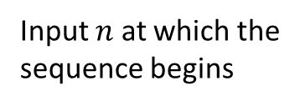

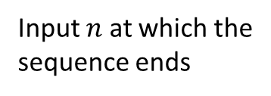
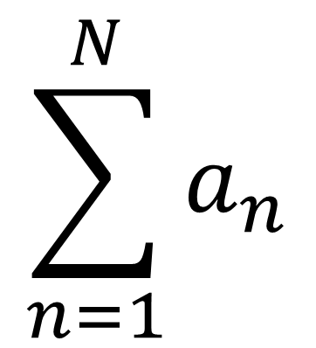

Series
Input $n$ at which the
sequence ends
A sum of all the terms in the sequence ${\left\{a_{n}\right\}}_{n=1}^{N}$ is called a series.
The sum $a_{1}+a_{2}+a_{3}+⋯+a_{N}$ is denoted as $S_{N}=\sum_{k=1}^{N}{a_{k}}$
$$\sum_{n=1}^{N}{a_{n}}$$
Formula to use
Input $n$ at which the
sequence begins
Ex) Write the series $1−\frac{1}{2}+\frac{1}{4}−\frac{1}{8}+⋯+\frac{1}{64}$ using
Sigma notation.
Ex) Write the series $4+8+16+32+64+⋯$ using
Sigma notation.

Slide 9


Series
Input $n$ at which the
sequence ends
A sum of all the terms in the sequence ${\left\{a_{n}\right\}}_{n=1}^{N}$ is called a series.
The sum $a_{1}+a_{2}+a_{3}+⋯+a_{N}$ is denoted as $S_{N}=\sum_{k=1}^{N}{a_{k}}$
$$\sum_{n=1}^{N}{a_{n}}$$
Formula to use
Input $n$ at which the
sequence begins
Ex) Evaluate the series $\sum_{k=1}^{5}{(2k+1)}$.
Ex) Evaluate the series $\sum_{n=4}^{6}{2^{n}}$.

Slide 10

Series
Input $n$ at which the
sequence ends
A sum of all the terms in the sequence ${\left\{a_{n}\right\}}_{n=1}^{N}$ is called a series.
The sum $a_{1}+a_{2}+a_{3}+⋯+a_{N}$ is denoted as $S_{N}=\sum_{k=1}^{N}{a_{k}}$
$$\sum_{n=1}^{N}{a_{n}}$$
Formula to use
Input $n$ at which the
sequence begins
Ex) Evaluate the series $\sum_{k=1}^{5}{(2k+1)}$.
Ex) Evaluate the series $\sum_{n=4}^{6}{n^{2}}$.

Slide 11

Series
Input $n$ at which the
sequence ends
A sum of all the terms in the sequence ${\left\{a_{n}\right\}}_{n=1}^{N}$ is called a series.
The sum $a_{1}+a_{2}+a_{3}+⋯+a_{N}$ is denoted as $S_{N}=\sum_{k=1}^{N}{a_{k}}$
$$\sum_{n=1}^{N}{a_{n}}$$
Formula to use
Input $n$ at which the
sequence begins
Ex) Evaluate the series $\sum_{i=1}^{3}{(i+1)}$.
Ex) Evaluate the series $\sum_{n=4}^{6}{2^{n}}$.

Slide 12
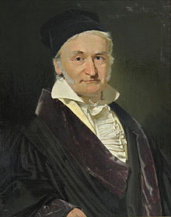

Sum of the first 100 numbers
Carl Friedrich Gauss (1777-1855) was a German mathematician and physicist.
In first grade, his schoolteacher as punishment assigned him the task of computing $1+2+3+⋯+99+100$.
He did so in a few short minutes. How?

Slide 13
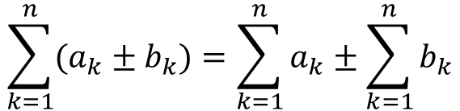
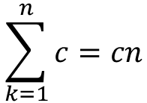
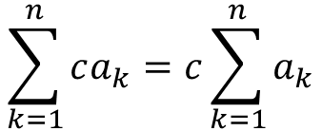
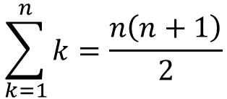


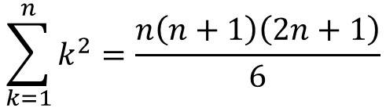
Formulas for Computing Summations
$$\sum_{k=1}^{n}{c}=cn$$
$$\sum_{k=1}^{n}{ca_{k}}=c\sum_{k=1}^{n}{a_{k}}$$
$$\sum_{k=1}^{n}{k}=\frac{n\left(n+1\right)}{2}$$
$$\sum_{k=1}^{n}{(a_{k}±b_{k})}=\sum_{k=1}^{n}{a_{k}}±\sum_{k=1}^{n}{b_{k}}$$
$$\sum_{k=1}^{n}{k^{2}}=\frac{n\left(n+1\right)\left(2n+1\right)}{6}$$
Ex) Evaluate the series $\sum_{k=1}^{1000}{k}$.
Ex) Evaluate the series $\sum_{k=1}^{6}{{\left(1+k\right)}^{2}}$.

Slide 14


Formulas for Computing Summations
$$\sum_{k=1}^{n}{c}=cn$$
$$\sum_{k=1}^{n}{ca_{k}}=c\sum_{k=1}^{n}{a_{k}}$$
$$\sum_{k=1}^{n}{k}=\frac{n\left(n+1\right)}{2}$$
$$\sum_{k=1}^{n}{(a_{k}±b_{k})}=\sum_{k=1}^{n}{a_{k}}±\sum_{k=1}^{n}{b_{k}}$$
$$\sum_{k=1}^{n}{k^{2}}=\frac{n\left(n+1\right)\left(2n+1\right)}{6}$$
A solution to a problem is in closed form if it can be expressed as a finite number of common operations.
Ex) Evaluate the series $\sum_{k=1}^{n}{\left(\frac{k^{2}}{n}\right)}$ in closed form.
Ex) Find a closed-form solution of the series:
$$\sum_{k=1}^{n}{{\left(3+\frac{4k}{n}\right)}^{2}}$$

